Slide 1


NEW OFFICE AVAILABLE FOR LEASING
20 SQM UP TO 690 SQM
BUILDING NAME : GATE WAY EL REHAB
CODE:P1901

Slide 2

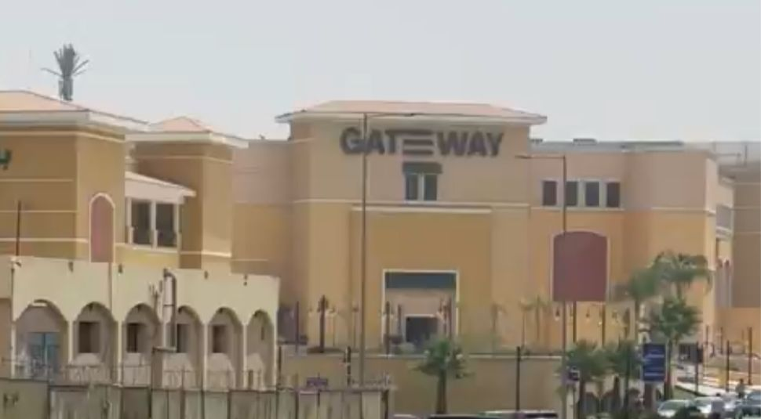
Table of Content:

Slide 3

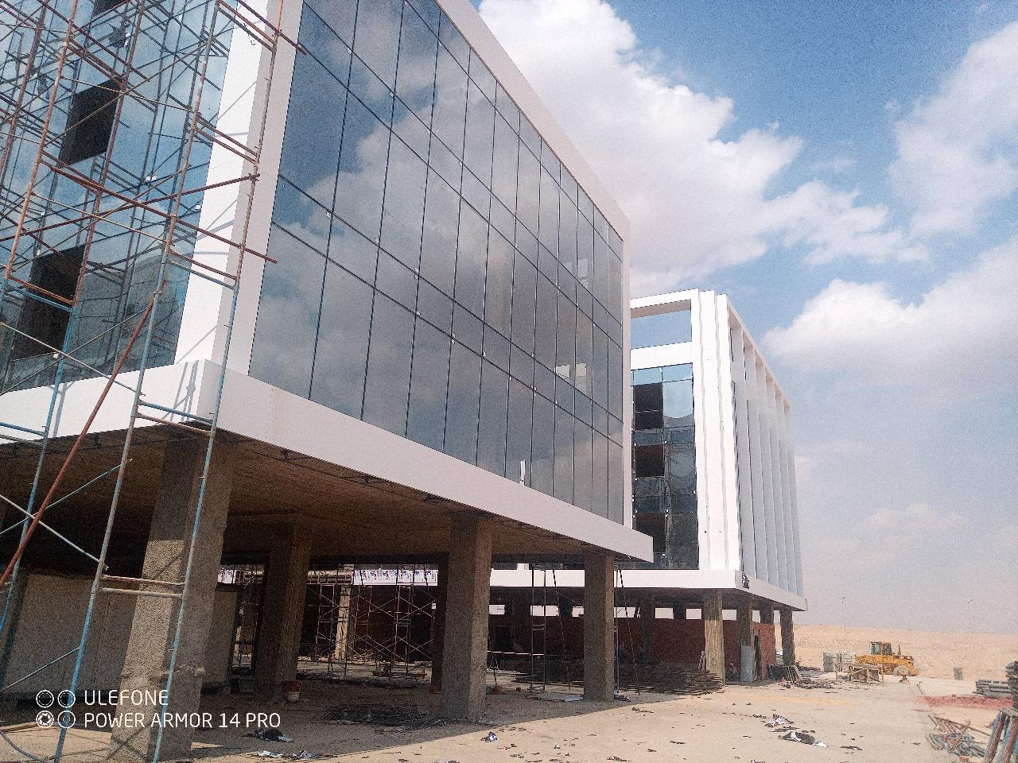
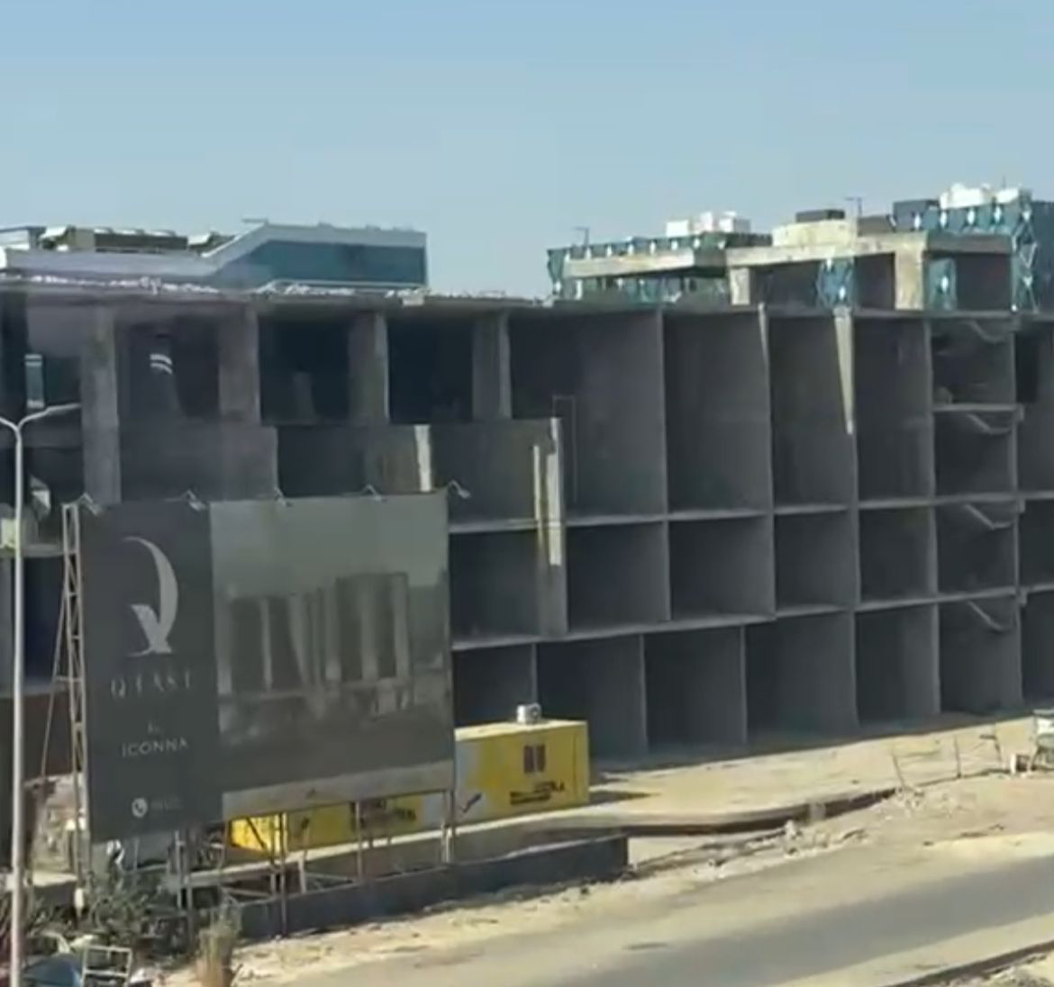
Building | Gate Way El Rehab
Area | 20 UP TO 690 SQM
Rent Rate Per Meters | EGP 2,500
Maintenance | Included
Annual increase | 10 %
Payment Method | Quarterly
Advanced | 3 Months
Security | 3 Months
Commission Fees | 1 Month
Condition | Furnished
Parking Slots | Available

Slide 4
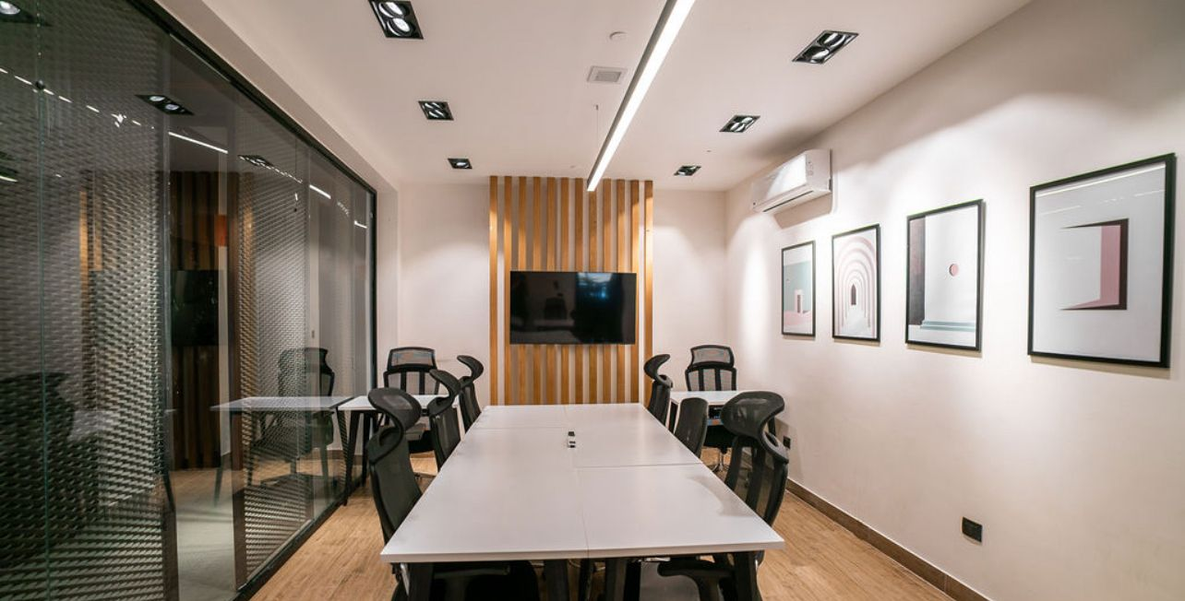
Table of Content:

Slide 5
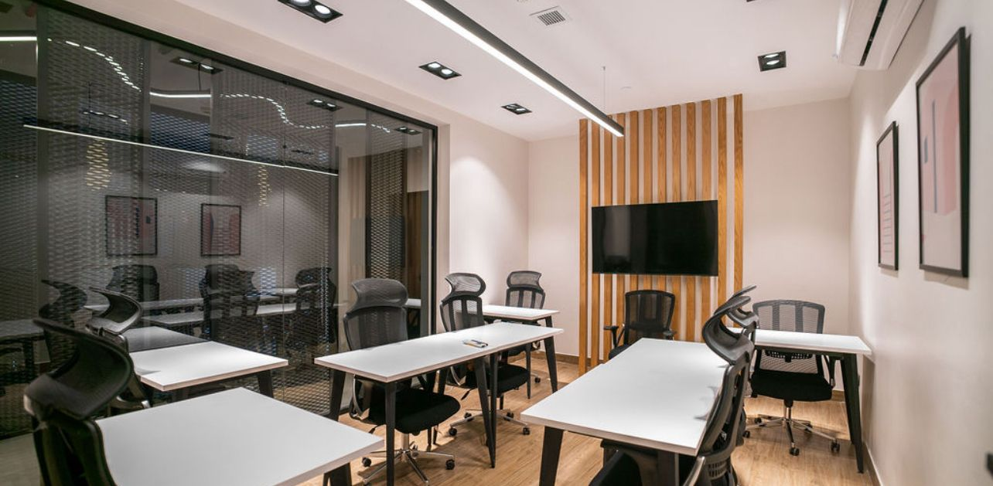
Table of Content:

Slide 6
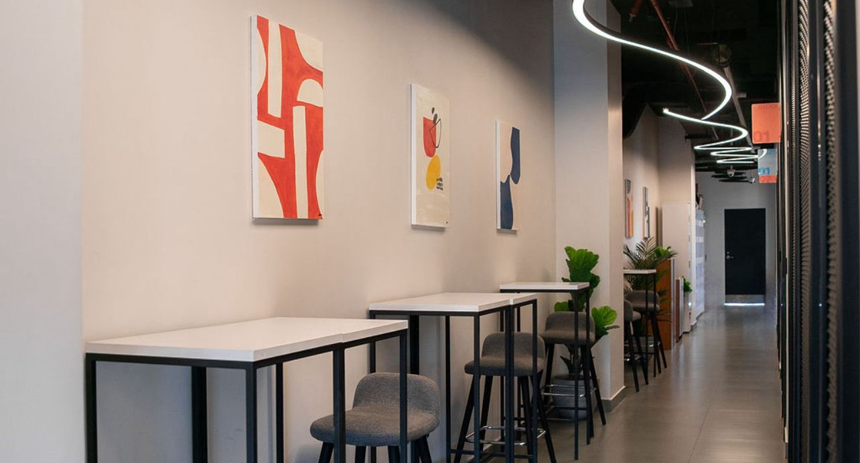
Table of Content:

Slide 7
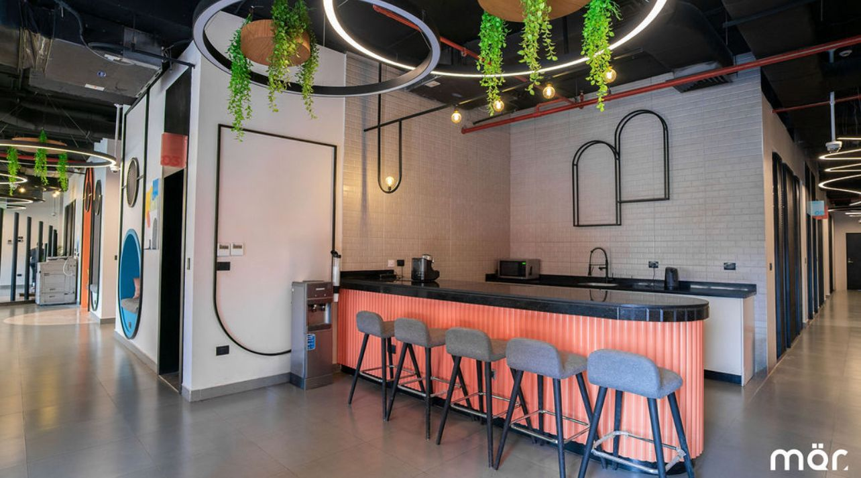
Table of Content:

Slide 8
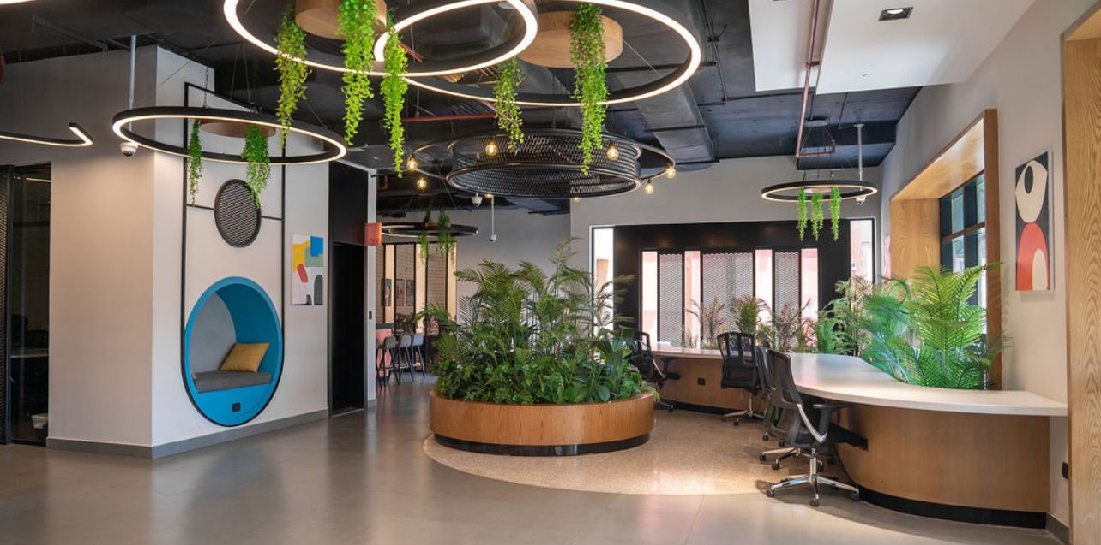
Table of Content:

Slide 9
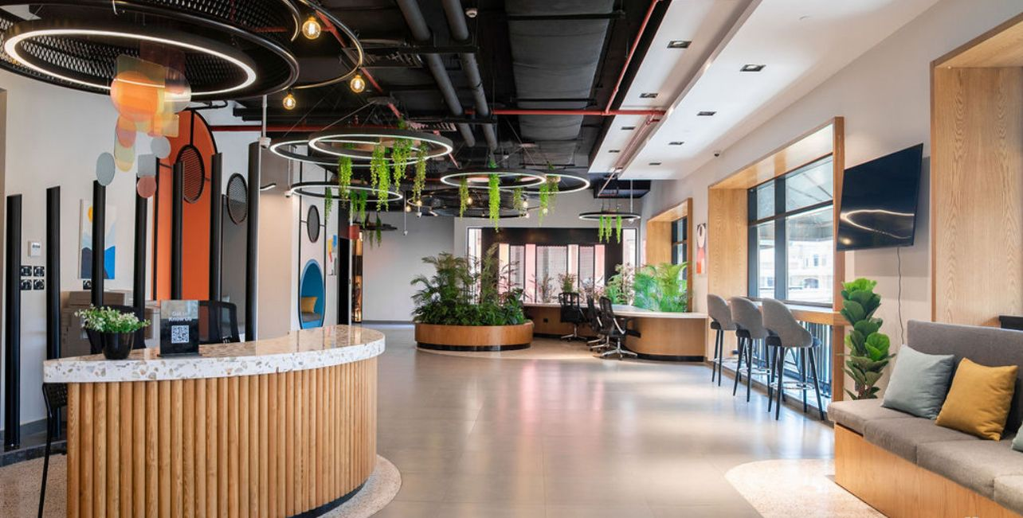
Table of Content:

Slide 10
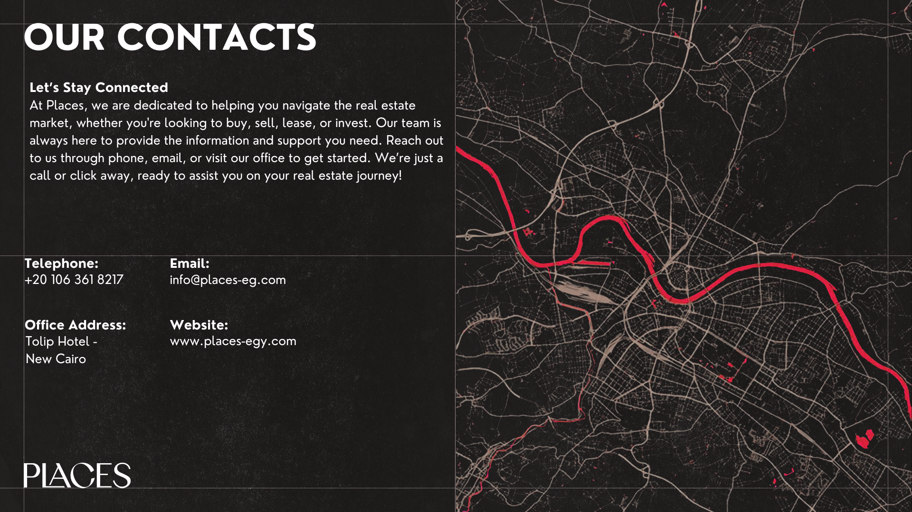

Slide 11
Thank you
Places-egy.com
Disclaimer: The material in this presentation has been prepared solely for informational purposes and is strictly confidential. Any disclosure, use, copying or circulation of this presentation (or the information contained within it) is strictly prohibited, unless you have obtained Savills prior written consent. Neither this presentation nor any part of it shall form the basis of, or be relied upon in connection with, any offer or transaction, or act as an inducement to enter into any contract or commitment whatsoever. NO WARRANTY OR REPRESENTATION, EXPRESS OR IMPLIED, IS GIVEN AS TO THE ACCURACY OR COMPLETENESS OF THE INFORMATION CONTAINED Places IS UNDER NO OBLIGATION TO SUBSEQUENTLY CORRECT IT IN THE EVENT OF ERRORS. Places shall not be held responsible for any liability whatsoever or for any loss howsoever arising from or in reliance upon the whole or any part of the contents of this document or any errors therein or omissions therefrom.

